Slide 1

WEEK 12 SOLID TEAM REPORT
BATCH 2

Slide 2
WEEKLY OBJECTIVES
1. COOK 2 FULL GRAINS
2. CONDUCT 3RD 2 GRAIN STATIC TEST.
3. FINISH UP ON THE 3 GRAIN MOTOR.

Slide 3
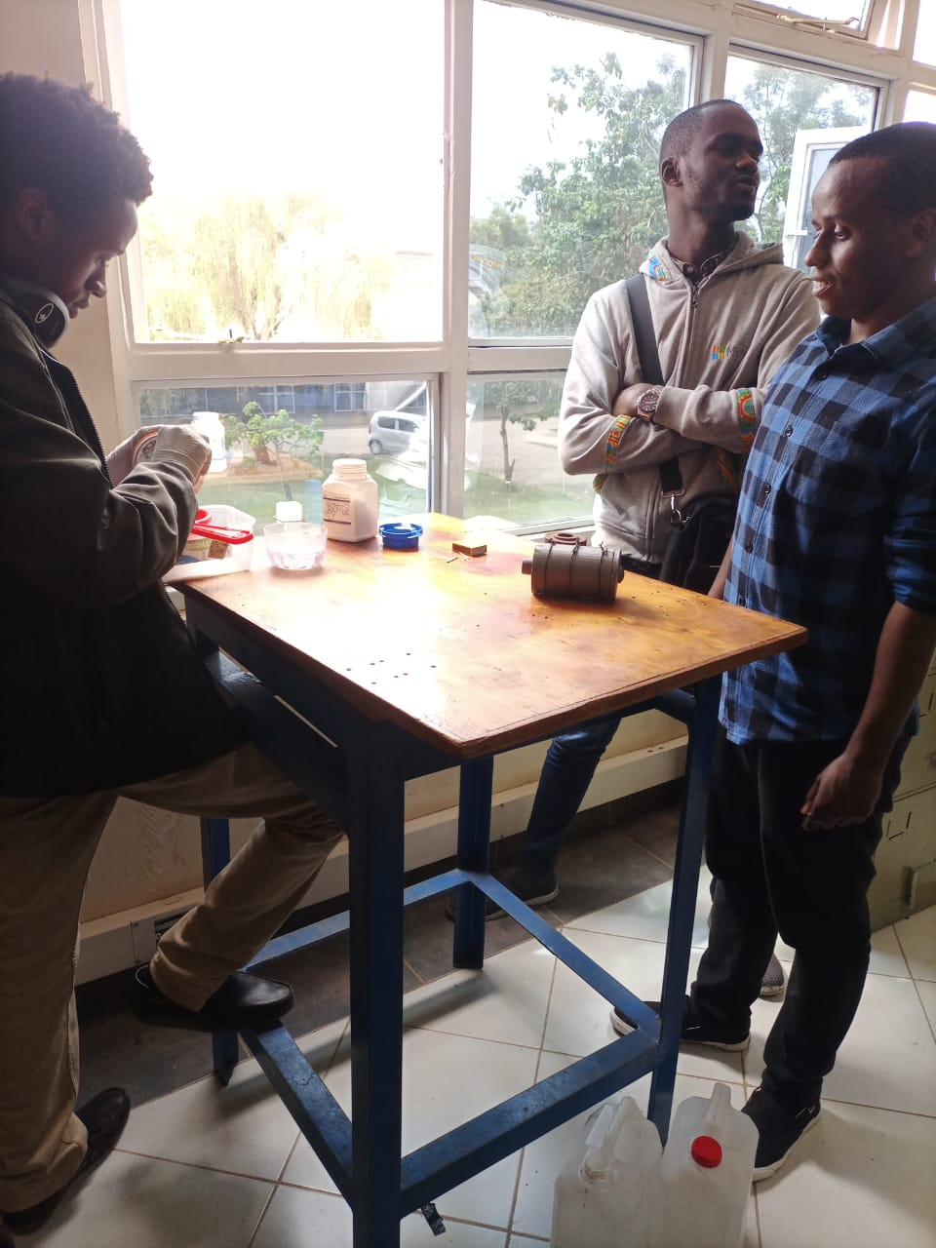
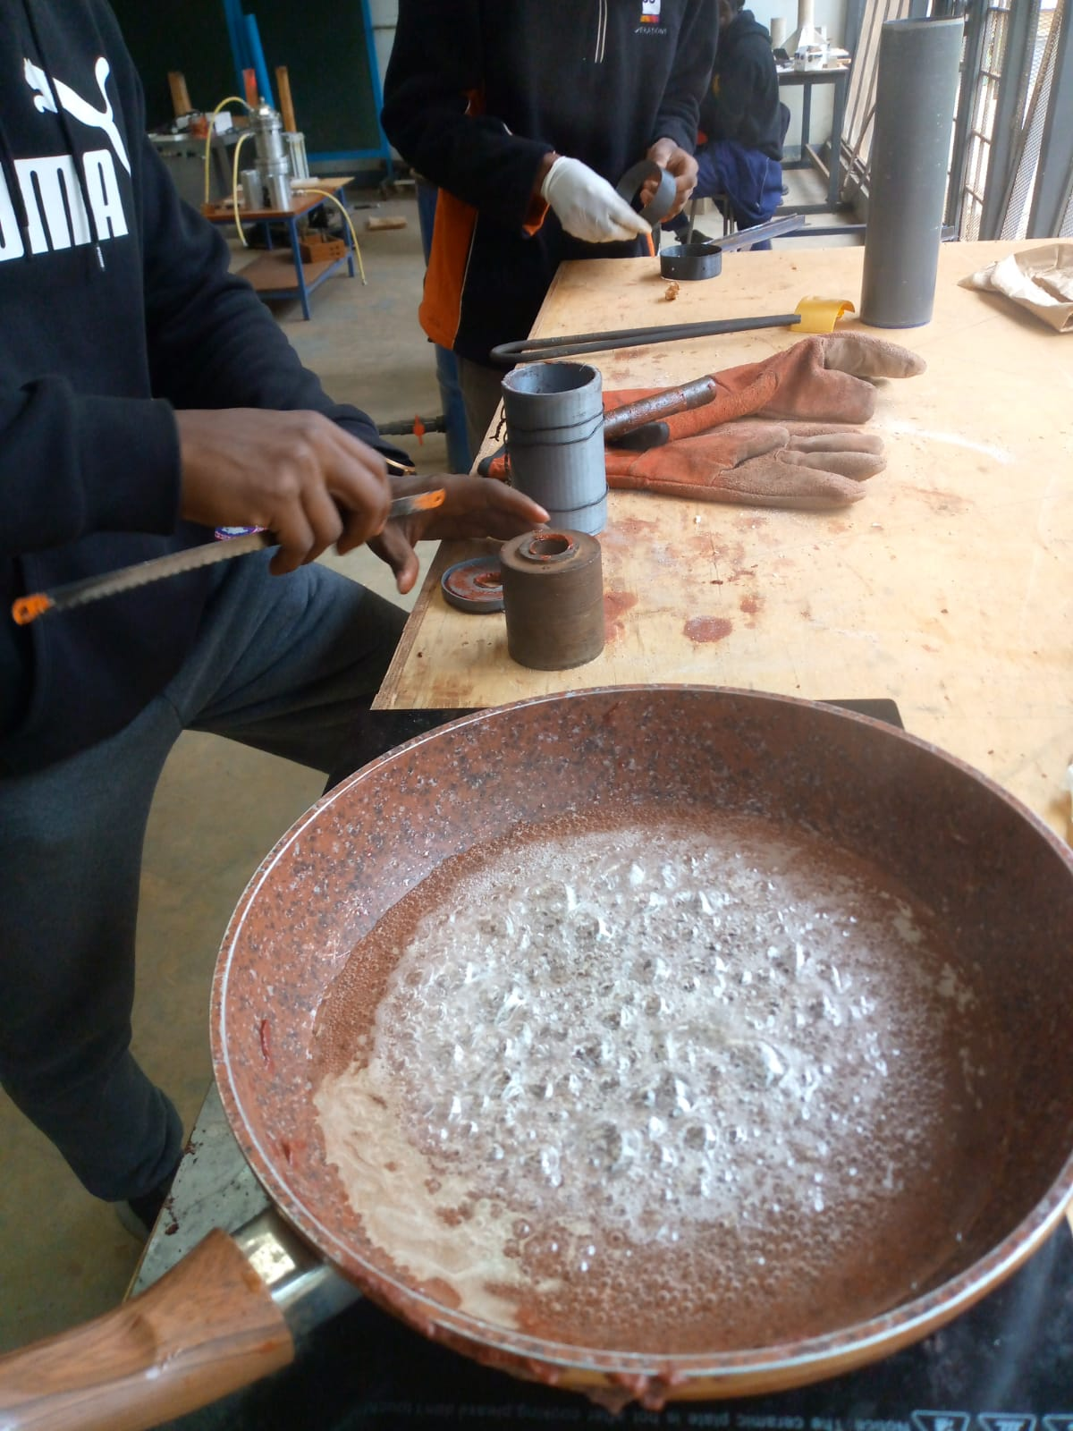
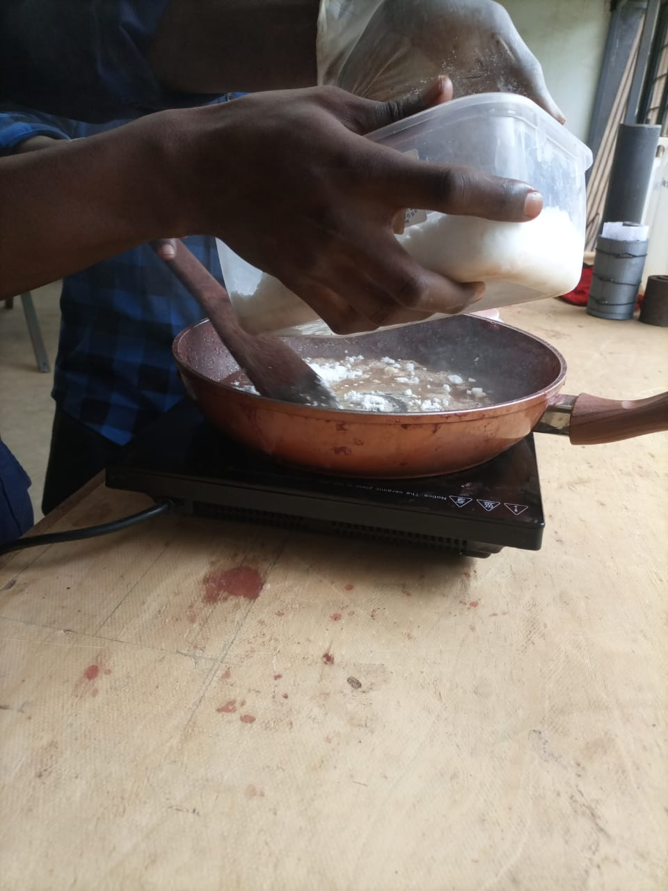
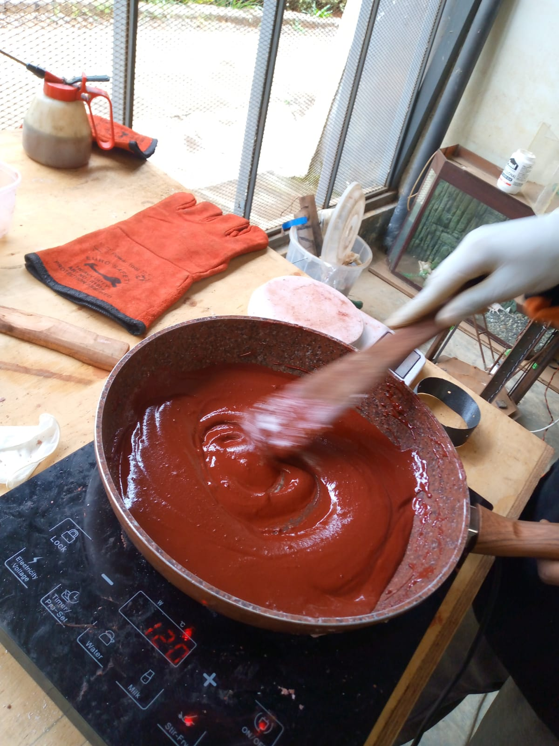
COOKING TWO GRAINS
For the KNSB propellant, we used an oxidizer-fuel (O/F) ratio of 67/33
We added 1% iron(iii)oxide of the total mass

Slide 4
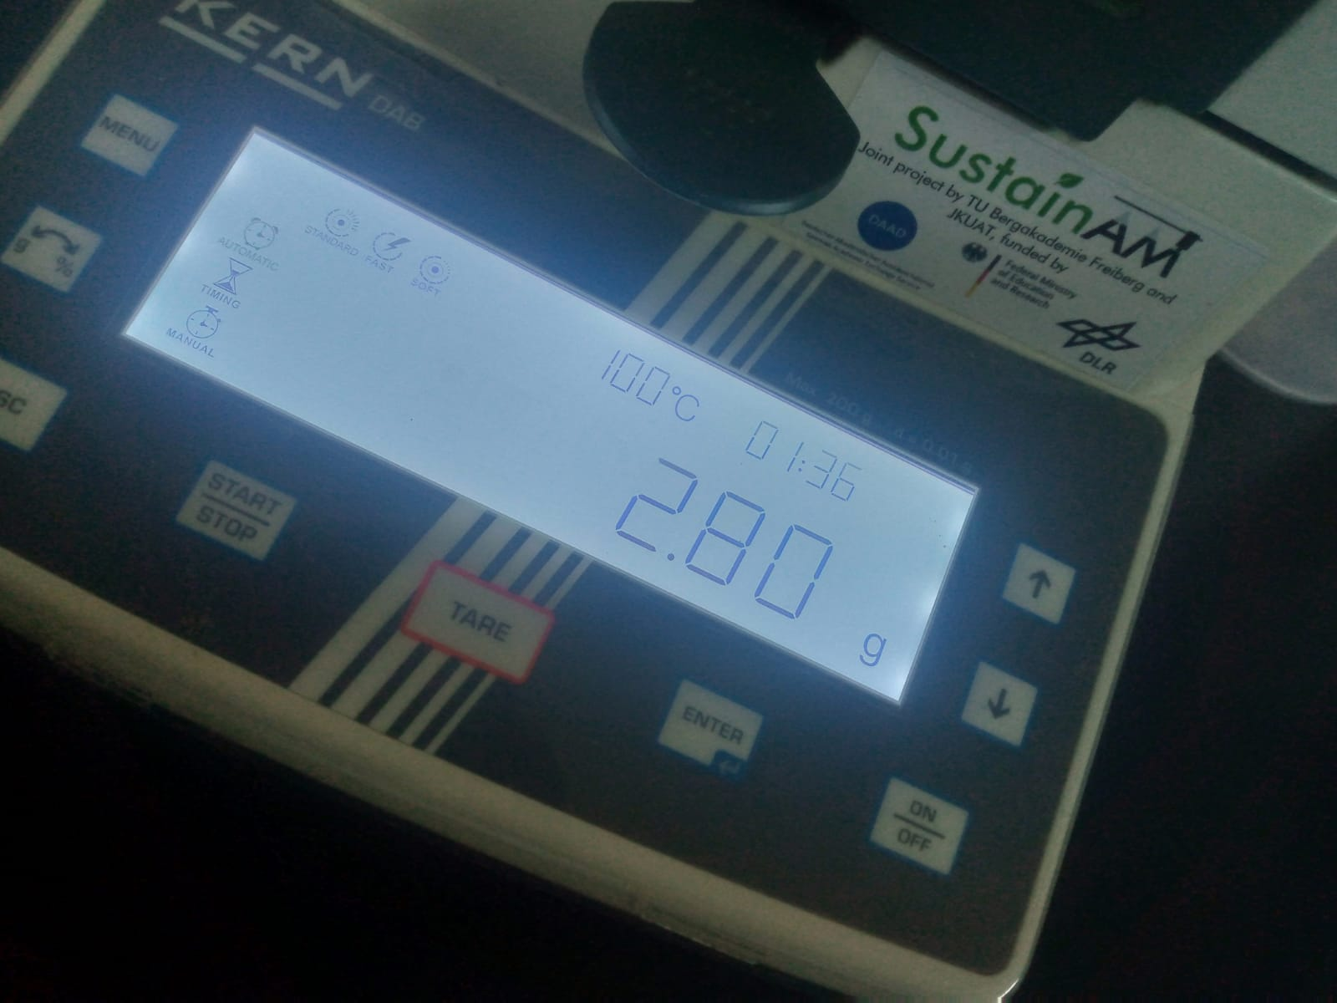
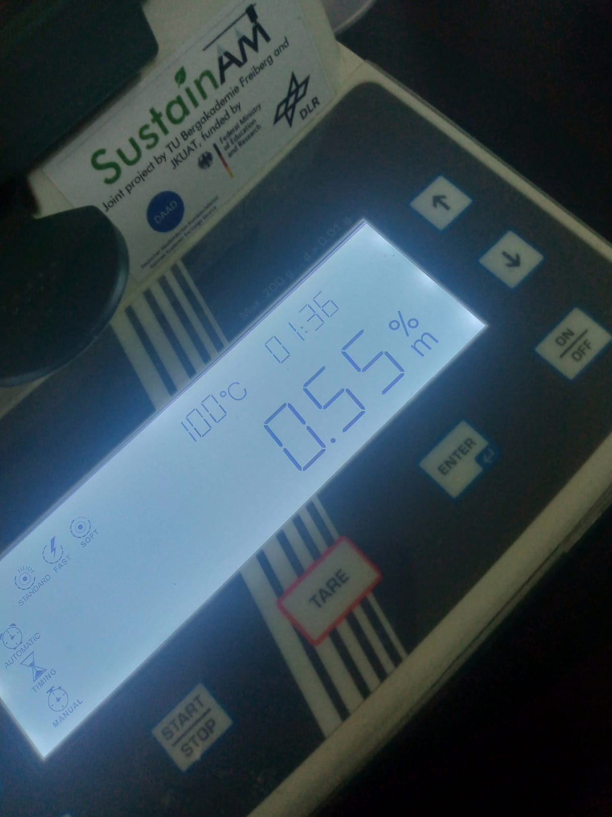
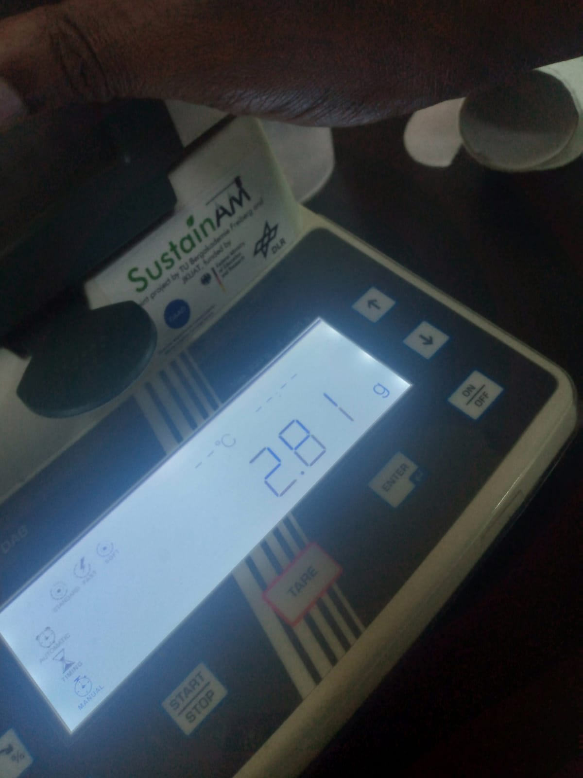
PERFORMING MOISTURE TEST
A sample of the propellant is placed into the moisture test analyzer
It heats the sample measuring the mass before and after
Using this change in mass it calculates the percentage of water in the sample

Slide 5
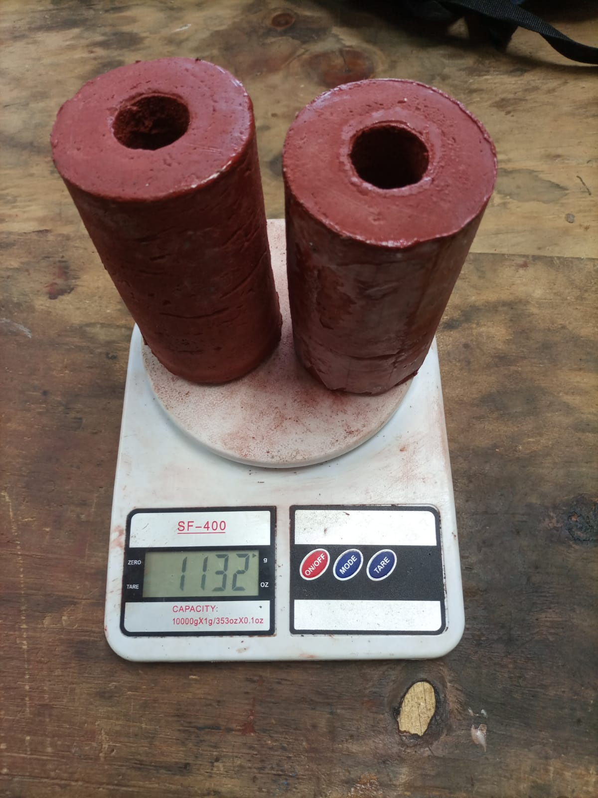
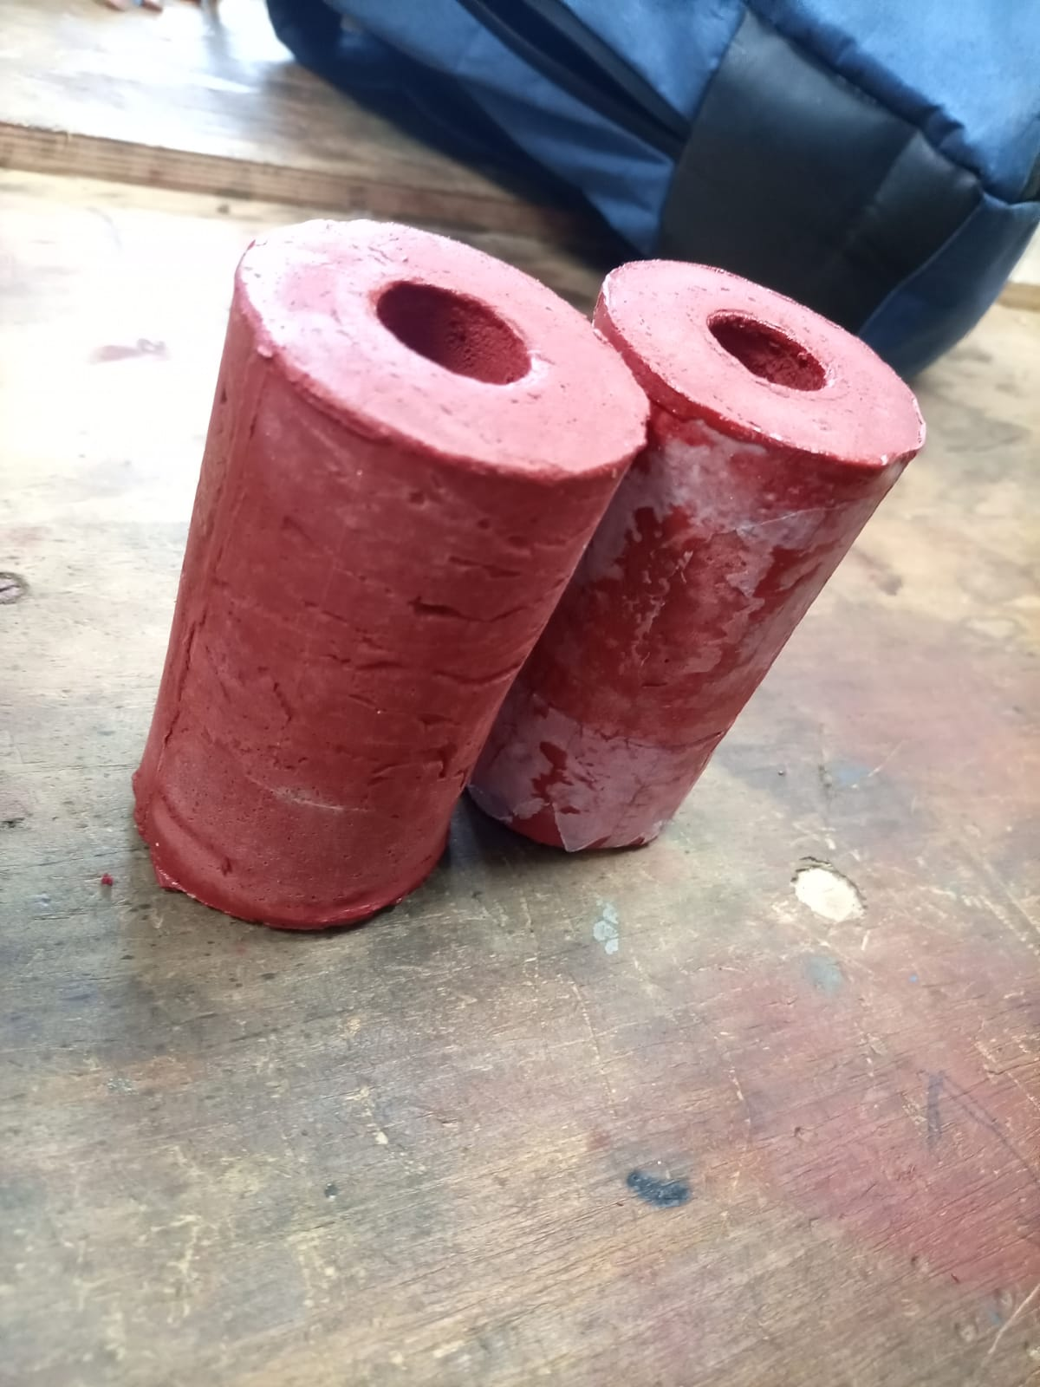
FINAL PRODUCT

Slide 6
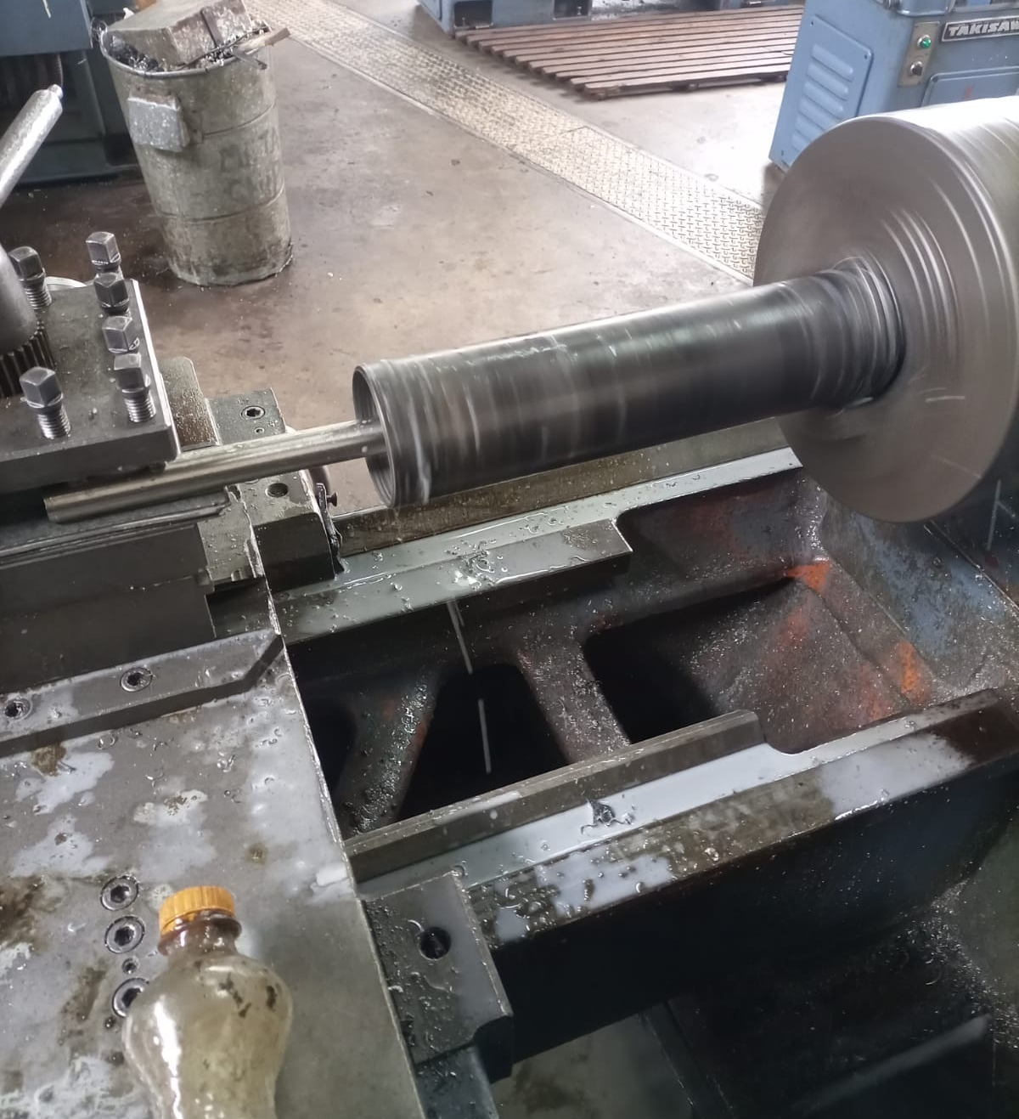

MACHINING THE CASING

Slide 7
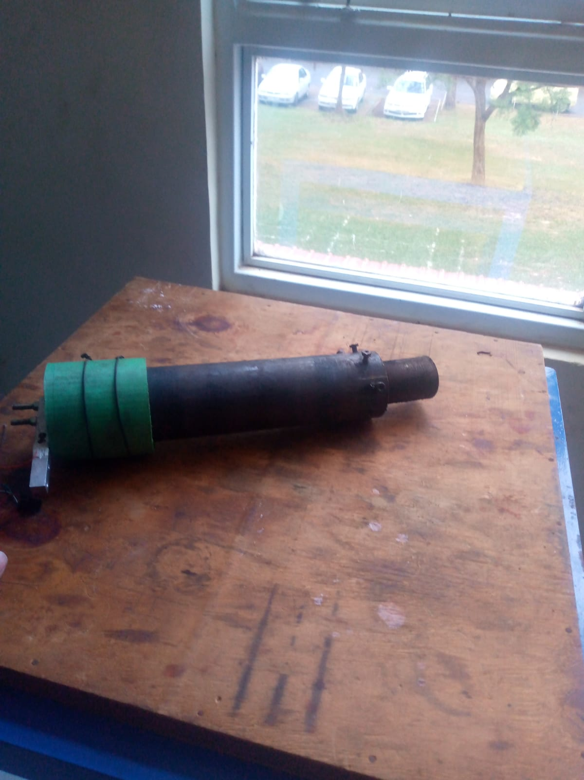
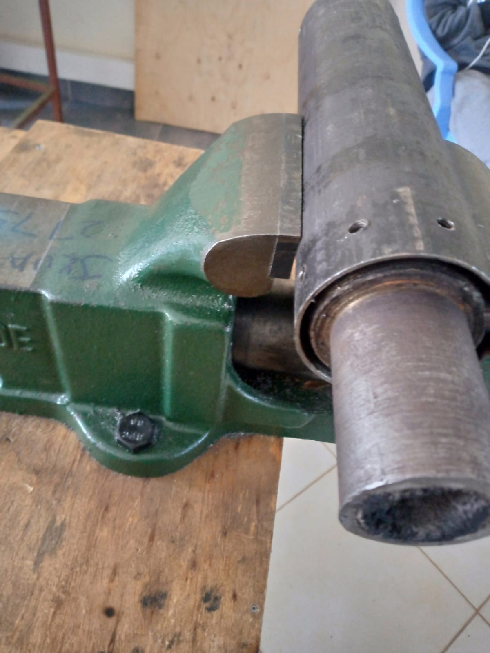
MOTOR ASSEMBLY

Slide 8
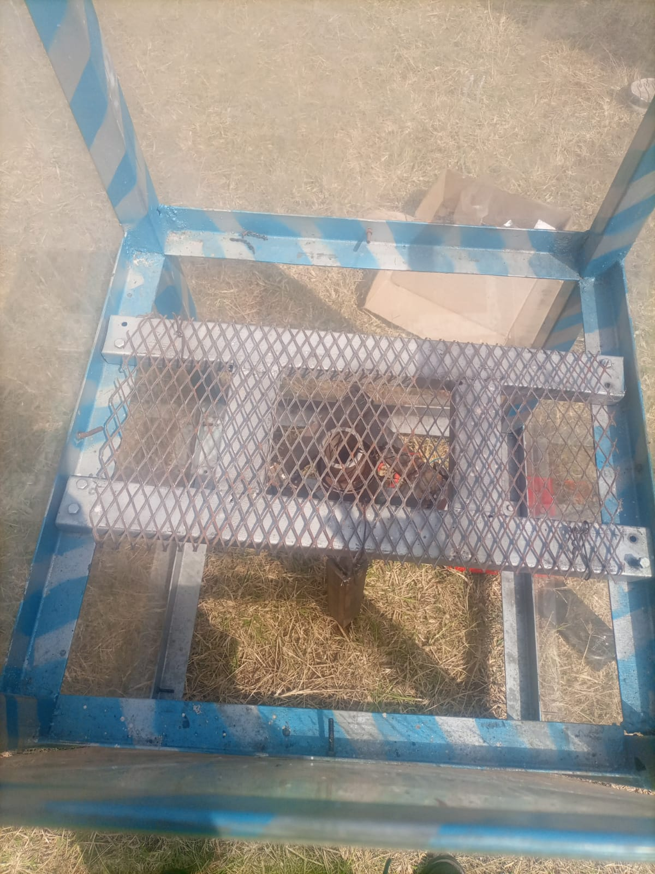
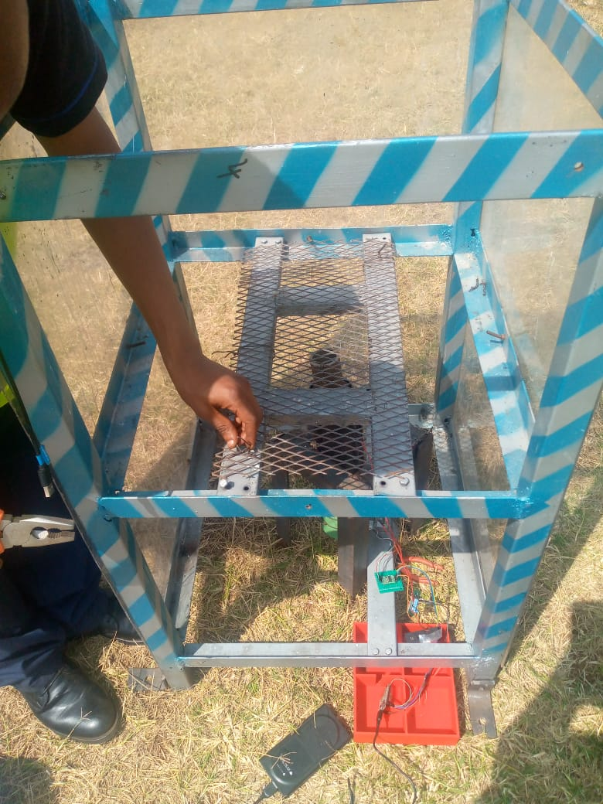
SETTING UP FOR STATIC TEST

Slide 9

IGNITION!

Slide 10
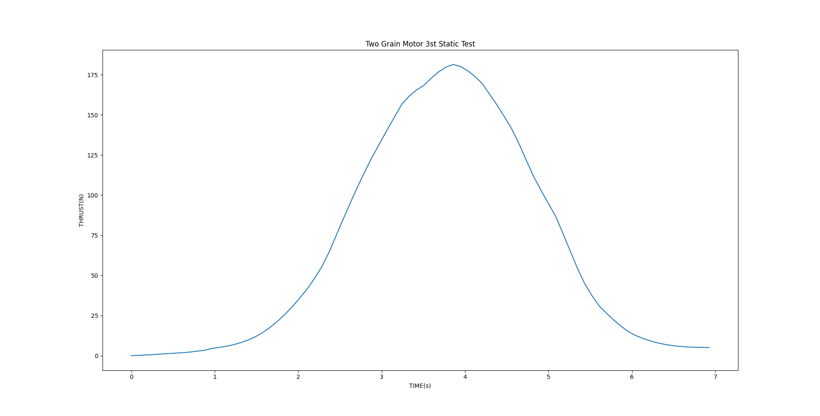
STATIC TEST RESULTS
Peak thrust: 181.4N
Total impulse: 459.15Ns

Slide 11
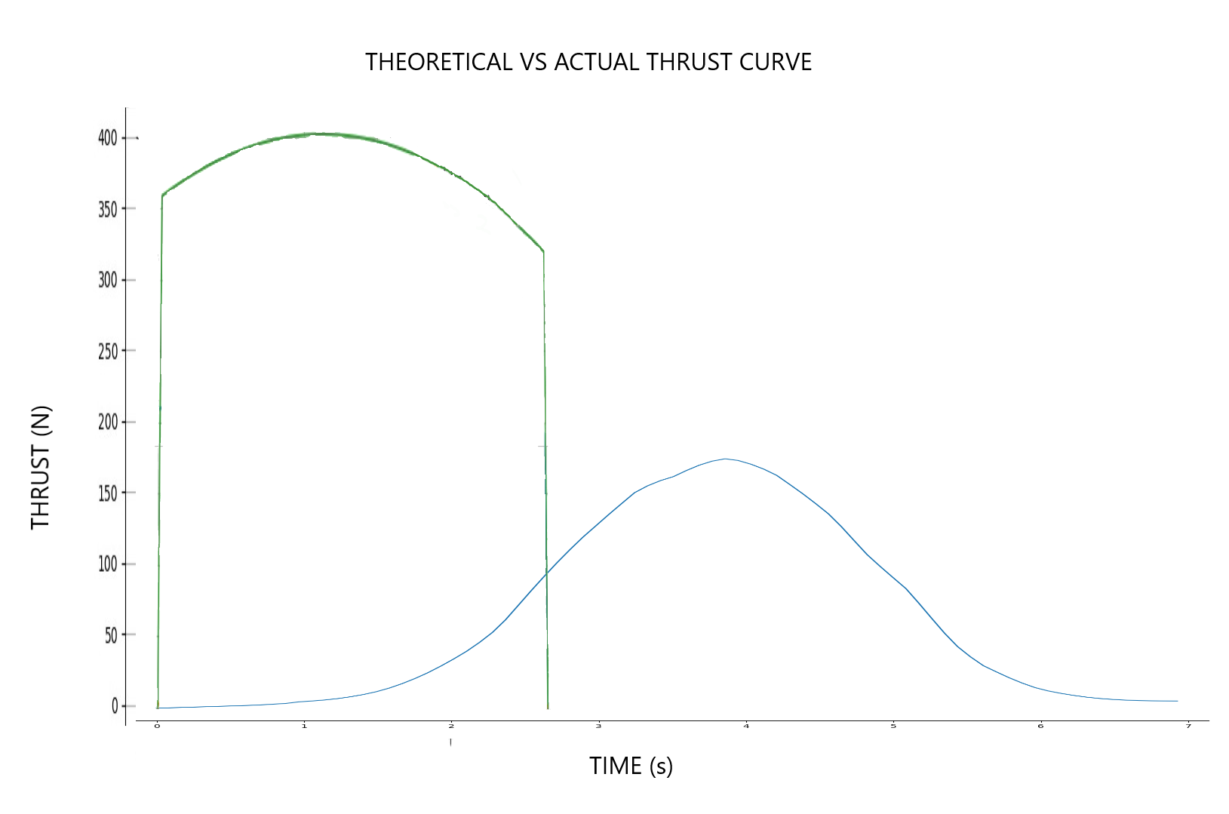
THEORETICAL VS ACTUAL THRUST CURVE
Peak thrust: 181.4N vs 400N
Total impulse: 459.15Ns vs 1002.23Ns

Slide 12
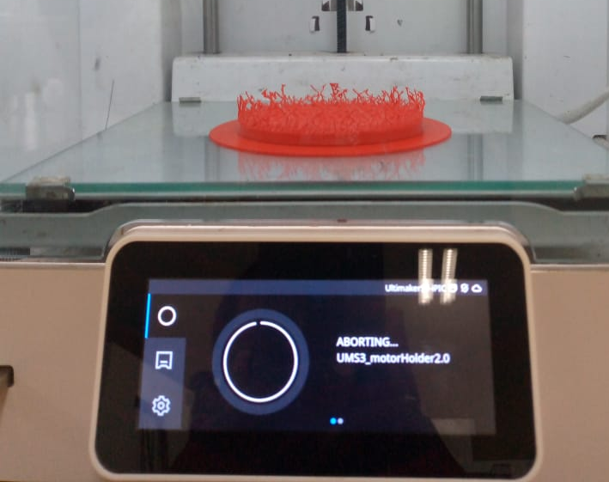
CHALLENGE ENCOUNTERED
Failed 3D print of the motor holder

Slide 13
NEXT WEEK’S OBJECTIVES
MACHINE THE THREE GRAIN CASING
COOK TWO GRAINS
3D PRINT MOTOR HOLDER AND CASTING TOOLS

Slide 14
THANK YOU

